Slide 1
종합설계
제목 : 야구 승부예측 시스템 (Baseball Match Prediction System)
부제 : 예측 및 분석 기능을 통한 머신러닝 알고리즘의 성능 향상
지도교수 : 박성호
(팀장) 학번 : 2018158010 이름 : 김형도
학번 : 2019316005 이름 : 김우현
학번 : 2021156009 이름 : 나세은
학번 : 2020156031 이름 : 전설

Slide 2
0. Intro
Dataframe row level of single game
하나의 df 가 몇 개로 압축될 수 있는가?
1
t
b
2
t
t
b
pitch
inning
3
t
inning_toplot
game_pk
match
b
....
....
b
1 vecter
n
9
t
2 vecter
b
n vecter
9 vecter

Slide 3
0. Intro
df 압축시 고려해야할 점
row : top, bot
col : pitch, swing
 | pitch | swing
top
bot

Slide 4
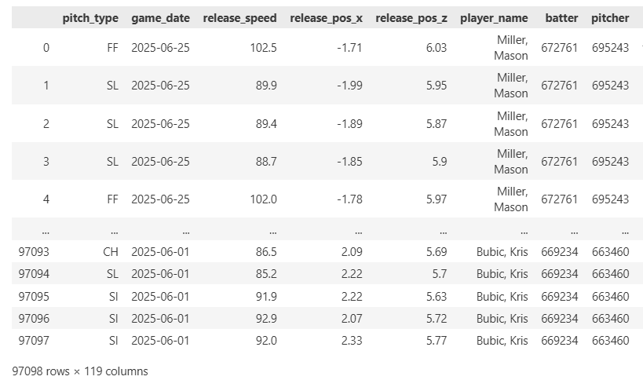
0. Intro
df 압축시 고려해야할 점
row : top, bot
col : pitch, swing

Slide 5
1. Data Loader
3.1k
fv_a
train
valid
test
fv
119
700k
2024
122k
2503
3/29 - 4/29
119k
2504
4/29 - 5/29
97k
2506
6/01 - 6/25
119
119
119
119
2.5k
fv_b
119

Slide 6
2. Pre-Processing
1) data_split
train
valid
test
fv_a, fv_b
x
meta
y
2) drop, fill, encoding

Slide 7
2. Pre-Processing
3) feature engineering
3-1) derived feature
3-2) time_operation(rolling, lag, diff)
derived raw
t derived_value rolling
spin_off = spin/speed
0 10 10
....
1 12 (10+12)/2=11
2 9 10.33
3 14 11.25
....

Slide 8
2. Pre-Processing
4) filtering - groupby (game_pk, inning_topbot)
train
fv_a
fv_b
A-B top f1...
A-B top f1...
A-B top f1...
A-B top f1...
A-B top f1...
A-B top f1...
....
....
....
700k
3.1k
2.5k
A-B bot f1...
A-C bot f1...
C-B bot f1...
A-B bot f1...
A-C bot f1...
C-B bot f1...
....
....
....
53
53
53
53 = 51 + game_pk + inning_topbot

Slide 9
2. Pre-Processing
4) filtering - apply
train
fv_a
fv_b
A-B top
A-B top
A-B top
A-B bot
A-B bot
A-B bot
4828
C-D top
22
A-C top
18
C-B top
C-D bot
A-C bot
C-B bot
....
....
....
53
53
53

Slide 10
2. Pre-Processing
fv_a
4) filtering - pivot
A-B f1_top f1_bot ...
11
A-C f1_top f1_bot ...
train
....
A-B f1_top f1_bot ...
102
2414
C-D f1_top f1_bot ...
fv_b
....
A-B f1_top f1_bot ...
102
11
C-B f1_top f1_bot ...
....
102

Slide 11
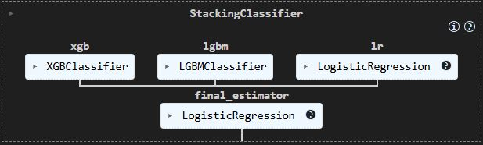
3. Train

Slide 12
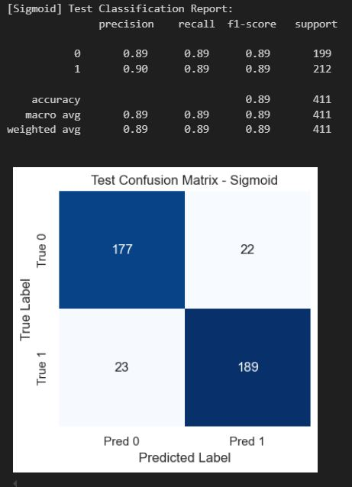
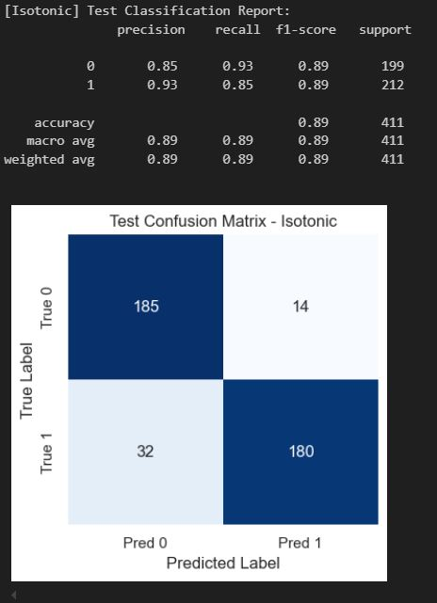
4. Eval

Slide 13
5. Prediction (single)
fv_a
fv_b
A-B f1_top f1_bot f2_top f2_bot ...
A-B f1_top f1_bot f2_top f2_bot ...
11
A-C f1_top f1_bot f2_top f2_bot ...
9
C-B f1_top f1_bot f2_top f2_bot ...
....
....
102
102

Slide 14
5. Prediction (single)
1) summarize()
fv_a
1
A-mlb f1_top f1_bot f2_top f2_bot ...
102
fv_b
1
mlb-B f1_top f1_bot f2_top f2_bot ...
102

Slide 15
5. Prediction (single)
2) is_pitch()
fv_a
pitch top
swing bot
A-mlb P1_top P1_bot S1_top S1_bot ...
fv_b
mlb-B P1_top P1_bot S1_top S1_bot ...
swing top
pitch bot

Slide 16
5. Prediction (single)
3) concat
fv
A-B P1_top P1_bot S1_top S1_bot ...
model
fv
proba a : proba b

